Slide 1
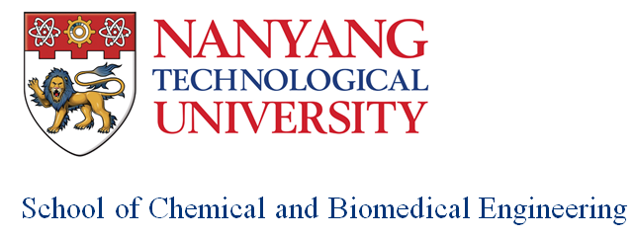
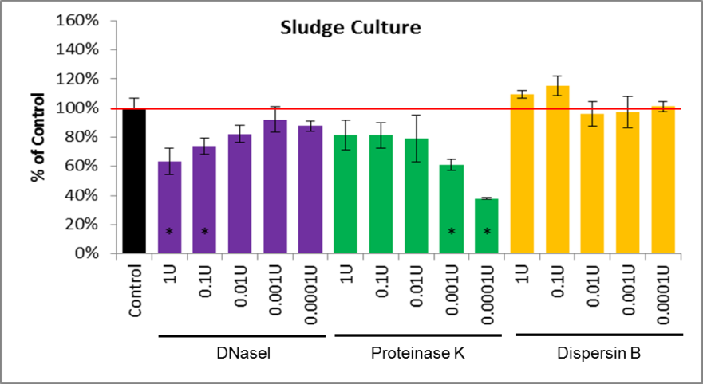
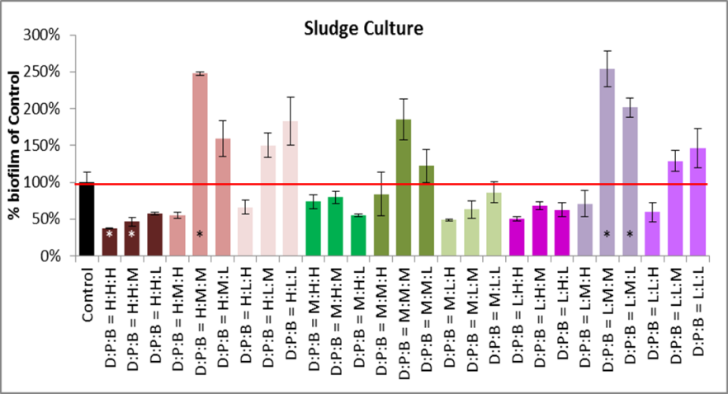
Right Enzyme Concentration is Needed to Reduce Initial Biofilm Formation
Poster12
High [enzyme] may not lead to low [biofilm]
In fact, [biofilm] is proportional to [Proteinase K]
Combination enzyme treatment “generally” ends up resulting in more biofilm
Likely to stress the cells into defensive mode
Objectives
Reduce biofilm formation in extractive membrane system
Control biofilm but not eliminate biofilm as biofilm is needed to prevent volatilization of organics
Hypotheses
[Biofilm] inversely proportional to [enzyme]
Combination enzyme treatment reduces more biofilm formation compared to single enzyme treatment
Setup
3 enzymes (DNaseI, Proteinase K, Dispersin B) in microplate setup (100 ul)
Conclusion
Higher [enzyme] is not always better – right [enzyme] works
Combination treatment may end up making things worse

